Slide 1




ONLINE PAYMENT
FRAUD DETECTION
P.PRIYADHARSHINI
IV YEAR B.TECH IT
REG NO:95072215041
FRANCIS XAVIER ENGINEERING COLLEGE

Slide 2
PROBLEM STATEMENT
  Online payment systems have become an essential part of today’s digital economy, enabling quick and convenient transactions worldwide. However, the increase in online payments has also led to a rise in fraudulent activities, causing major financial losses.
  Traditional rule-based systems fail to keep up with evolving fraud patterns, making it necessary to develop smarter detection methods.
  This project focuses on building a machine learning-based model to detect fraudulent online transactions by analyzing data such as transaction amount, time, and user behavior. The model will learn to differentiate between genuine and fraudulent activities using historical transaction data. This approach aims to improve accuracy, reduce false alerts, and enhance the overall security of online payment systems.

Slide 3
ABSTRACT
  Online payment fraud detection is an essential system designed to identify and prevent unauthorized or suspicious financial transactions in real-time.
  With the rise of digital payments, detecting fraudulent activities such as fake transactions, identity theft, and account takeovers has become increasingly important.
  This project uses machine learning algorithms to analyze transaction data and identify patterns that distinguish legitimate transactions from fraudulent ones.
  By training models on historical payment data, the system learns to detect unusual behaviors and predict the likelihood of fraud before it happens.
  The main goal is to ensure secure, reliable, and fast online payment processing while minimizing financial losses and protecting users’ trust
i

Slide 4
INTRODUCTION
Online payment fraud happens when someone uses another person’s payment information like credit card or bank details to make illegal transactions. As digital payments are becoming more common, these frauds are also increasing.To prevent this, Machine Learning (ML) can be used. ML helps computers learn from past transaction data and identify patterns that indicate whether a transaction is genuine or fraudulent. In this system, data such as transaction amount, time, location, and user behavior are analyzed. The ML model is trained to spot unusual or suspicious activity, such as sudden large purchases or payments from new locations. Once trained, it can predict frauds automatically in real-time, reducing losses and improving security.
i

Slide 5
OBJECTIVES
  To detect and prevent fraudulent online payment transactions using machine learning.
  To analyze transaction data and identify patterns that indicate fraudulent activity.
  To develop an accurate model that distinguishes between genuine and fraudulent transactions.
  To minimize false alerts and enhance the reliability of the detection system.
  To implement a real-time monitoring system for secure and safe online payments.

Slide 6
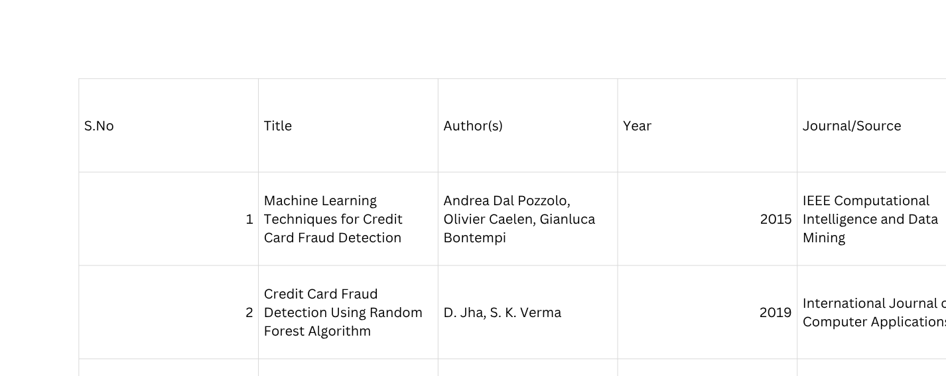
LITERATURE SURVEY

Slide 7
EXISTING SYSTEM
  The existing system relies on manual or rule-based methods to detect fraudulent online transactions.
  It uses predefined rules such as transaction amount limits, location mismatches, or unusual login activity to flag potential fraud.
  These systems often generate a high number of false alerts and fail to detect new or evolving fraud patterns.
  They lack the ability to learn from past data and adapt to changing fraudulent behaviors.
  As a result, fraud detection is slower, less accurate, and less efficient in preventing real-time payment fraud.

Slide 8
PROPOSED SYSTEM
  The proposed system uses machine learning techniques to detect fraudulent online payment transactions.
  Transaction data is collected, cleaned, and analyzed to identify suspicious behavior patterns.
  Important features such as transaction amount, location, and time are used to train the model.
  Algorithms like Random Forest, Decision Tree, or XGBoost are applied to classify transactions as genuine or fraudulent.
  The trained model is deployed to monitor and detect fraud in real time, ensuring secure online payments.

Slide 9
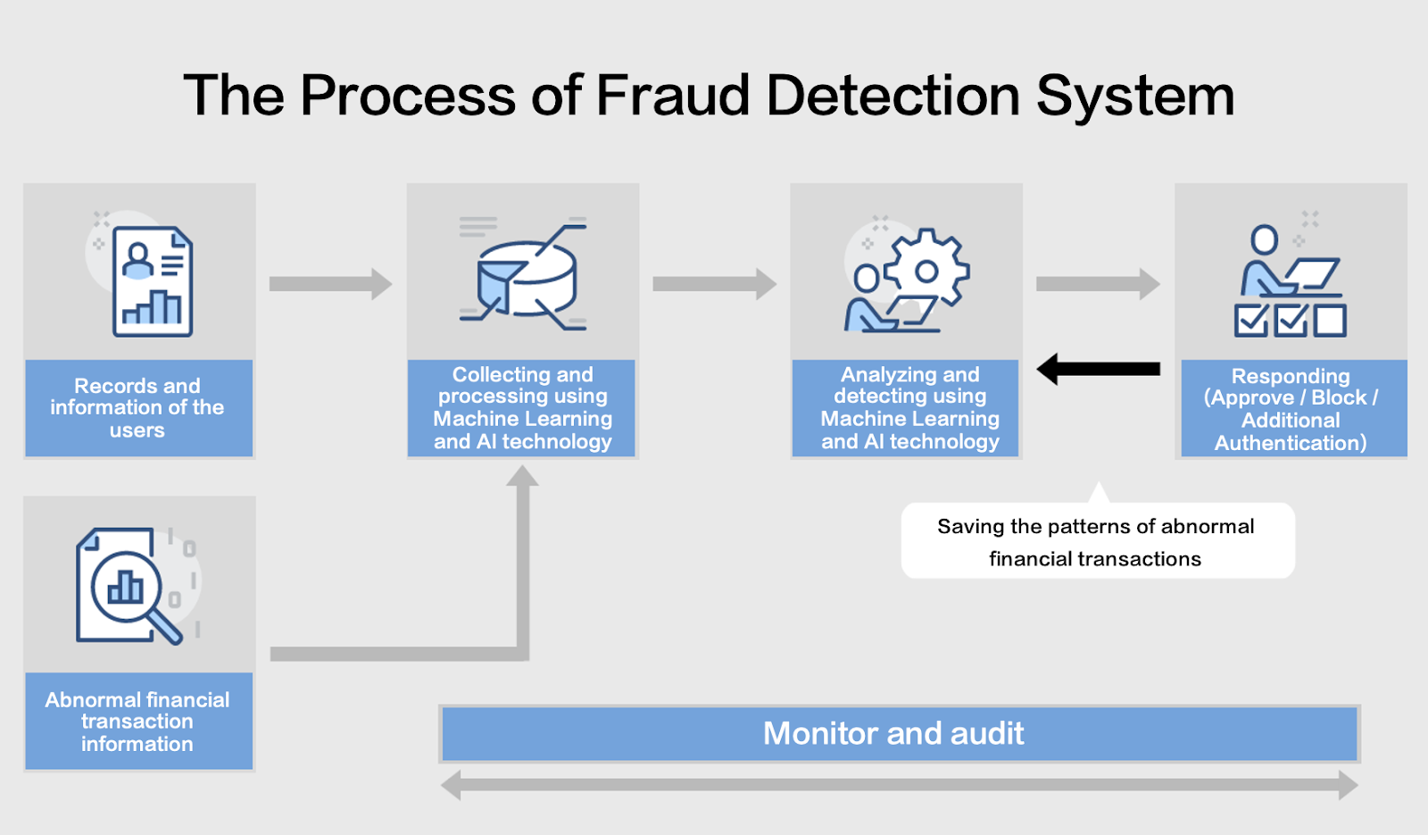
ARCHITECTURE DIAGRAM

Slide 10
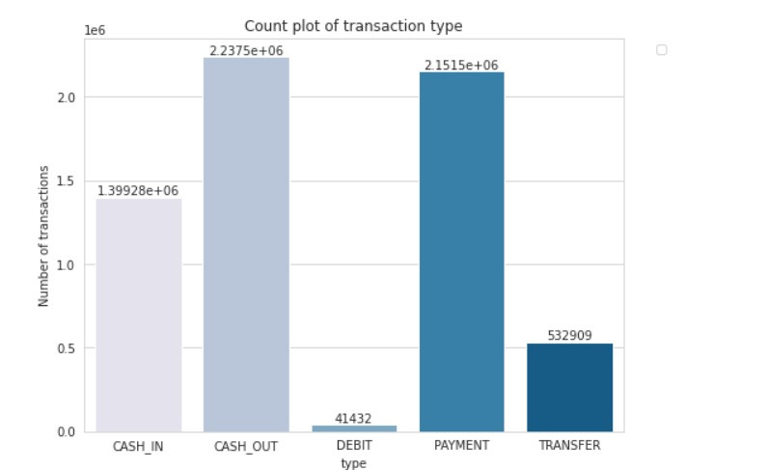
OUTPUT

Slide 11
MODULE DESCRIPTION
Data Collection:
Collect a dataset containing records of both genuine and fraudulent online transactions.The data may include features like transaction amount, time, location, and payment method.
Data Preprocessing:
Clean the dataset removing duplicates, handling missing values and normalizing data. Encode categorical features and scale numerical values for better model performance.
Feature Engineering:
Identify and create meaningful features that capture abnormal transaction behavior.
Examples include frequency of transactions, average spending, and unusual location changes.

Slide 12
MODULE DESCRIPTION
Model Training:
Use the training dataset to teach models how to identify fraudulent transaction patterns.
Optimize hyperparameters to enhance accuracy and reduce false positives.
Model Evaluation:
Test the trained models using the testing dataset to measure performance.
Evaluate using metrics like accuracy, precision, recall, and F1-score for balanced results.
Deployment and Monitoring:
Deploy the selected model into a real-time transaction processing system.
Continuously monitor model performance and update it with new transaction data.

Slide 13
CONCLUSION
Online payment fraud detection using machine learning provides an efficient and intelligent way to identify fraudulent transactions. By analyzing transaction patterns, user behavior, and key features, the system can accurately distinguish between genuine and suspicious activities. Machine learning models such as Logistic Regression, Random Forest, and XGBoost help improve detection accuracy and reduce financial losses. Overall, this approach enhances the security of online payment systems, protects users, and builds trust in digital financial platforms.

Slide 14
REFERENCES
  A. Dal Pozzolo, O. Caelen, Y.-A. Le Borgne, S. Waterschoot, and G. Bontempi, “Learned lessons in credit card fraud detection from a practitioner perspective,” Expert Systems with Applications, vol. 41, no. 10, pp. 4915–4928, 2014.
  R. Sharma and A. Gupta, “Online Payment Fraud Detection Using Machine Learning Techniques,” International Research Journal of Engineering and Technology (IRJET), vol. 7, no. 6, pp. 1025–1030, 2020.
  P. Singh and N. Patel, “Real-Time Fraud Detection in E-Payment Systems Using XGBoost Algorithm,” IEEE Access, vol. 10, pp. 56789–56798, 2022.
  Y. Kim and J. Lee, “Deep Learning for Credit Card Fraud Detection,” Journal of Information Security and Applications, vol. 58, pp. 102–115, 2021.

Slide 15
THANK YOU

